Slide 1

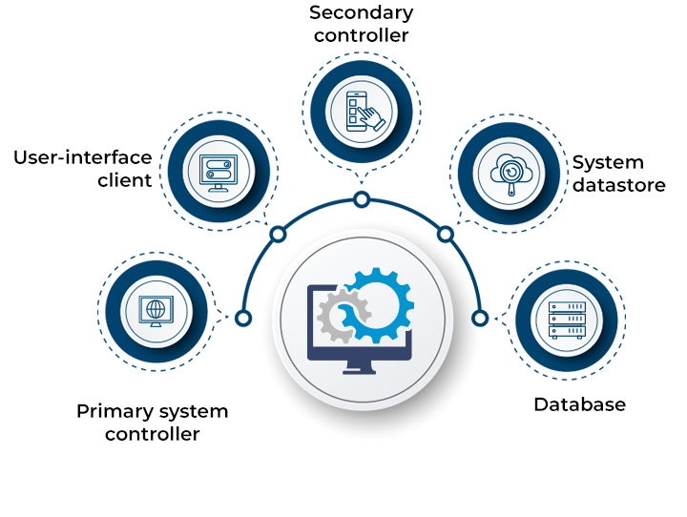
Sistem Terdistribusi IF2222
Ujian Akhir Semester
Husni
2022-23 Ganjil

Slide 2

Distributed Hash Table (DHT)
DHT is a distributed system that provides a lookup service similar to a hash table
(key, value) pair is stored in the nodes participating in the DHT
The responsibility for maintaining the mapping from keys to values is distributed among the nodes
Any participating node can serve in retrieving the value for a given key
We will study a representative DHT known as Chord
DATA
KEY
DISTRIBUTED NETWORK
Pink Panther
Hash function
ASDFADFAD
Participating Nodes
Satu.Sister.net
Hash function
DGRAFEWRH
88.87.86.85
Hash function
4PINL3LK4DF

Slide 3
Chord
Entity with k
Node n (node with id=n)
000
Chord assigns an m-bit identifier (randomly chosen) to each node
A node can be contacted through its network address
Alongside, it maps each entity to a node
Entities can be processes, files, etc.,
Mapping of entities to nodes
Each node is responsible for a set of entities
An entity with key k falls under the jurisdiction of the node with the smallest identifier id >= k. This node is known as the successor of k, and is denoted by succ(k)
003
Node 000
004
008
Node 005
040
079
Node 010
Node 301
Map each entity with key k to node succ(k)

Slide 4
A Naïve Key Resolution Algorithm
The main issue in DHT is to efficiently resolve a key k to the network location of succ(k)
Given an entity with key k, how to find the node succ(k)?
19
00
01
02
03
04
05
06
07
08
09
10
11
12
13
14
15
16
17
18
19
20
21
22
23
24
25
26
27
28
29
30
31
All nodes are arranged in a logical ring according to their IDs
Each node ‘p’ keeps track of its immediate neighbors: succ(p) and pred(p)
If ‘p’ receives a request to resolve key ‘k’:
If pred(p) < k <=p, node p will handle it
Else it will forward it to succ(n) or pred(n)
Solution is not scalable:
As the network grows, forwarding delays increase
Key resolution has a time complexity of O(n)
n
= Active node with id=n
p
= No node assigned to key p

Slide 5
Key Resolution in Chord
1 | 04
2 | 04
3 | 09
4 | 09
5 | 18
succ(p + 2^{(i-1)})
Chord improves key resolution by reducing the time complexity to O(log n)
All nodes are arranged in a logical ring according to their IDs
Each node ‘p’ keeps a table FT_{p} of at-most m entries. This table is called Finger Table
FT_{p}[i] = succ(p + 2^{(i-1)})
NOTE: FT_{p}[i] increases exponentially
If node ‘p’ receives a request to resolve key ‘k’:
Node p will forward it to node q with index j in F_{p} where
q = FT_{p}[j] <= k < FT_{p}[j+1]
If k > FT_{p}[m], then node p will forward it to FT_{p}[m]
If k < FT_{p}[1], then node p will forward it to FT_{p}[1]
i
1 | 01
2 | 01
3 | 01
4 | 04
5 | 14
1 | 09
2 | 09
3 | 09
4 | 14
5 | 20
00
01
02
03
04
05
06
07
08
09
10
11
12
13
14
15
16
17
18
19
20
21
22
23
24
25
26
27
28
29
30
31
26
1 | 11
2 | 11
3 | 14
4 | 18
5 | 28
1 | 28
2 | 28
3 | 28
4 | 01
5 | 09
1 | 14
2 | 14
3 | 18
4 | 20
5 | 28
1 | 21
2 | 28
3 | 28
4 | 28
5 | 04
1 | 20
2 | 20
3 | 28
4 | 28
5 | 04
1 | 18
2 | 18
3 | 18
4 | 28
5 | 01

Slide 6
Chord – Join and Leave Protocol
In large-scale distributed Systems, nodes dynamically join and leave (voluntarily or due to failures)
If a node p wants to join:
It contacts arbitrary node, looks up for succ(p+1), and inserts itself into the ring
If node p wants to leave:
It contacts pred(p) and succ(p+1) and updates them
00
01
02
03
04
05
06
07
08
09
10
11
12
13
14
15
16
17
18
19
20
21
22
23
24
25
26
27
28
29
30
31
Node 4 is succ(2+1)
Who is succ(2+1) ?
02

Slide 7
Chord – Finger Table Update Protocol
For any node q, FT_{q}[1] should be up-to-date
It refers to the next node in the ring
Protocol:
Periodically, request succ(q+1) to return pred(succ(q+1))
If q = pred(succ(q+1)), then information is up-to-date
Otherwise, a new node p has been added to the ring such that q < p < succ(q+1)
FT_{q}[1] = p
Request p to update pred(p) = q
Similarly, node p updates each entry i by finding succ(p + 2^{(i-1)})

Slide 8
Exploiting Network Proximity in Chord
The logical organization of nodes in the overlay network may lead to inefficient message transfers
Node k and node succ(k +1) may be far apart
Chord can be optimized by considering the network location of nodes
Topology-Aware Node Assignment
Two nearby nodes get identifiers that are close to each other
Proximity Routing
Each node q maintains ‘r’ successors for i^{th} entry in the finger table
FT_{q}[i] now refers to r successor nodes in the range
[p + 2^{(i-1)}, p + 2^{i} -1]
To forward the lookup request, pick one of the r successors closest to the node q

Slide 9
Ujian Akhir Semester (UAS)
Membuat tutorial mengenai Distributed Hash Table: How it works by examples
Hash table (Struktur data), contoh dan kekurangannya
Distributed Hash Table (DHT):
Consistent hashing: Chord
Rendezvous hashing
Perbandingan Consistent vs. Rendezvous hashing
Contoh aplikasi dari DHT (boleh consistent atau Rendezvous).

